Slide 1

Regional & Urban Economics: Wages

Slide 2
Structure
I. Relevance
II. Theoretical Background
III. Empirical Evidence
UK: Duranton & Monastiriotis (2000)
US: Glaeser & Maré (2001)
Fr: Combes, Duranton & Gobillon (2008)
Five OECD countries: Ahrend, Farchy, Kaplanis & Lembcke (2017)
IV. Other available datasets
V. Conclusion

Slide 3
I. Relevance
Growing inequalities is a topic of special importance
Growing inequality can hamper economic development (IMF, 2017)
→ One cause of this inequality lies in growing wage disparities across countries and regions
Emphasis in the literature is on the effect of agglomeration on wage – the urban wage premium → our focus as well and not other regional differences
e.g. US: Wages 33% higher in big cities than outside (Glaeser & Maré, 2001)

Slide 4
I. Relevance
Weber (1899) showed that the urban wage premium in nineteenth-century Germany was over 50%
Wage differences are increasing in many countries over the last three decades
Reasons of existence and increases of significant wage disparities between cities and regions are still debated
Q: WHY ARE WAGES IN BIG CITIES HIGHER THAN IN NON-METROPOLITAN AREAS?

Slide 5
II. THEORY: why are wages higher in metropolitan areas? Three explanations
Skill-composition – cities might attract more able workers
Higher educational level in cities → Aggregate regional inequalities
Omitted ability bias: Higher inherent ability → Higher productivity → Higher wages
Migration to cities → don’t receive a wage premium
Wage level theory
Between-industry-interaction & local endowments (demand, cheaper inputs, matching, location)
Migration to cities → immediate receive a wage gain
Migration away from cities → receive a wage loss
Wage growth theory
Agglomeration effect: Human capital accumulation grow with density due to spatial spillovers
Interaction between experience and working in an urban area
Migration away from cities → keep wage premium

Slide 6
II. THEORY: why are wages higher in metropolitan areas? Three explanations
Skill-composition – cities might attract more able workers
Higher educational level in cities → Aggregate regional inequalities
Omitted ability bias: Higher inherent ability → Higher productivity → Higher wages
Migration to cities → don’t receive a wage premium
Wage level theory
Between-industry-interaction & local endowments (demand, cheaper inputs, matching, location)
Migration to cities → immediate receive a wage gain
Migration away from cities → receive a wage loss
Wage growth theory
Agglomeration effect: Human capital accumulation grow with density due to spatial spillovers
Interaction between experience and working in an urban area
Migration away from cities → keep wage premium

Slide 7
II. THEORY: why are wages higher in metropolitan areas? Three explanations
Skill-composition – cities might attract more able workers
Higher educational level in cities → Aggregate regional inequalities
Omitted ability bias: Higher inherent ability → Higher productivity → Higher wages
Migration to cities → don’t receive a wage premium
Wage level theory
Between-industry-interaction & local endowments (demand, cheaper inputs, matching, location)
Migration to cities → immediate receive a wage gain
Migration away from cities → receive a wage loss
Wage growth theory
Agglomeration effect: Human capital accumulation grow with density due to spatial spillovers
Interaction between experience and working in an urban area
Migration away from cities → keep wage premium
Notes:
Local endowments that can lead to higher wages: Greater labour demand, cheaper inputs, better labour market matching, favorable location (availability of capital, technology, institutions, geographic: port, river, bridge, climate, natural resources)

Slide 8
III. Empirical evidence
Special aspects
Education: The skill composition? (Duranton & Monastiriotis, 2000)
Migration: Omitted ability, wage level, or wage growth effect? (Glaeser & Maré, 2001)
Interaction effects and local endownment? (Combes, Duranton & Gobillon, 2008)
Fragmented governance structures (Ahrend, Farchy, Kaplanis & Lembcke, 2017)

Slide 9
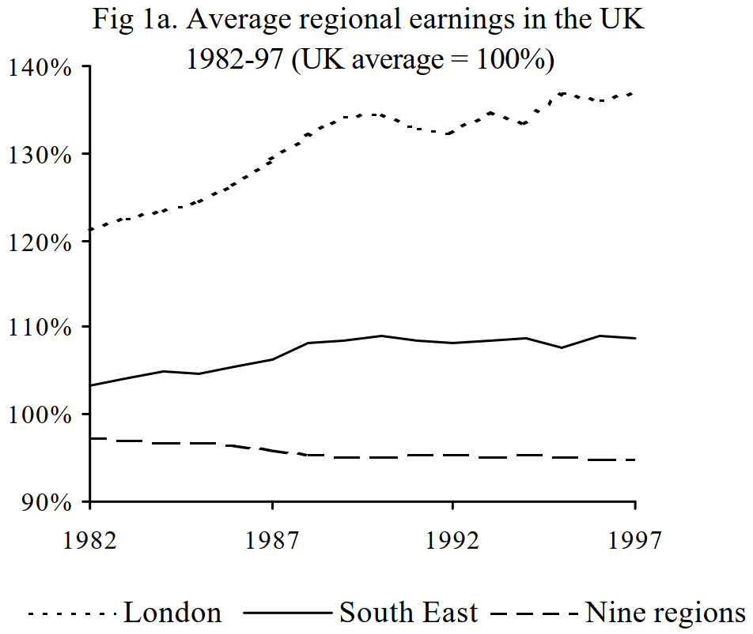
Duranton & Monastiriotis (2000) “Mind the gaps: The evolution of regional inequalities in the UK 1982-1997”
Can growth in aggregate regional inequality be explained by the skill-composition?

Slide 10
Duranton & Monastiriotis (2000): Mind the gaps
Yearly data, 1982-1997
Continuous cross-section: FES - Family Expenditure Survey
Continuous random sample 4,000-6,000 full-time employees per year
Robustness check: GHS - General Household Survey
Panel of 9,000 households (does not cover Northern Ireland)
Regions
The twelve UK administrative regions
Focus on Greater London and surrounding area: South-West (& East of England / E. Anglia)
Including Scotland, Wales, and Northern Ireland (poorest region)
Region of residence not of workplace → commuting plays a role

Slide 11
Duranton & Monastiriotis (2000): Mind the gaps
Measurement
The real wage, i.e. the wage relative to regional price levels
“Required incomes“ price index → assumes no substitution between goods
→ Housing prices explain most of the regional difference
→ Over-estimate cross-regional differences in price levels
Using nominal wage instead of real wage → No equalization of regional fixed effects
Education is in years of schooling
Not in level, field or quality of education → Regional differences in returns to education can be sensitive to inter-regional or inter-temporal differences in composition of education
→ Weakens internal and external validity of results

Slide 12
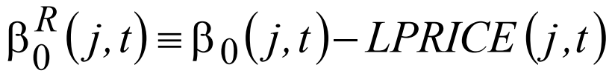
Duranton & Monastiriotis (2000): Mind the gaps
Estimation of log real weakly earnings for individual i in region j
Where
And the real regional fixed effect is

Slide 13
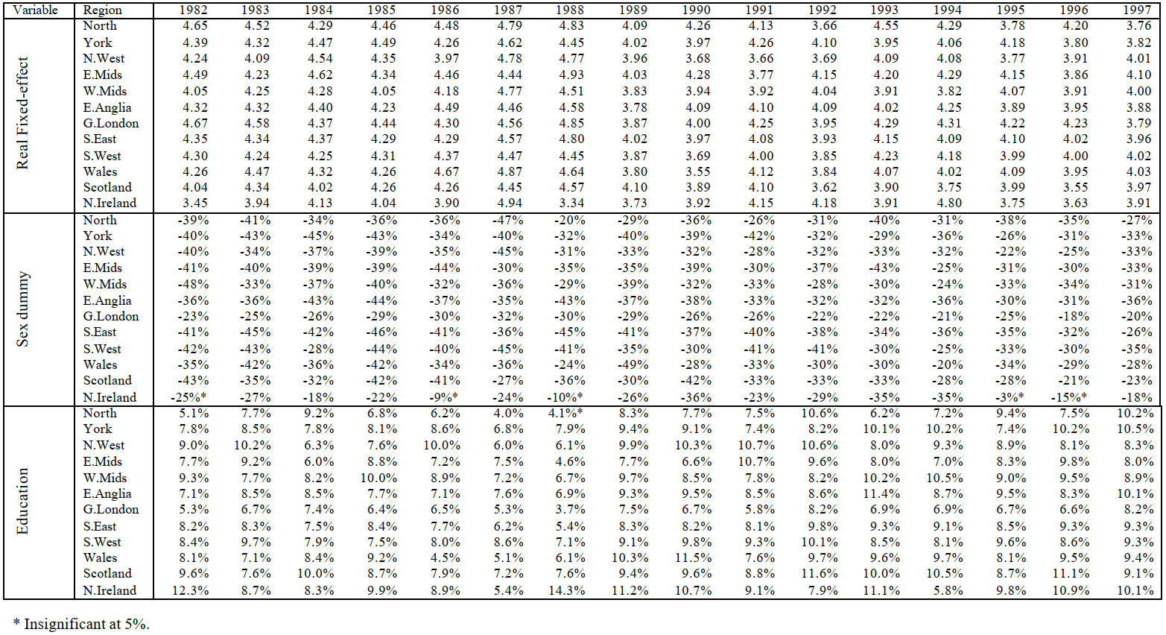
Notes:
The 374 metropolitan statistical areas (MSAs) are shown in medium green. Definition in 2013 is > 50.000 inhabitants in center.

Slide 14
Duranton & Monastiriotis (2000): Mind the gaps
Using microeconometrics and decomposition it is found that
Aggregate figures are misleading
Regional convergence in returns to wages from:
Education, experience, gender, and regional fixed effects → no wage level effect
Explanations of larger average wage growth in London and the South East
London initially had lower returns to education
Catch up effect: Disaggregate convergence in returns to education → Aggregate divergence in income between regions
Growing inequality between skilled and unskilled
Uneven spatial distribution of human capital → Aggregate divergence in income
Growth in average level of education attained relative to other regions
London initially had higher female participation and less discrimination in wages
Regional convergence in gender participation → Regional divergence in average wage

Slide 15
Duranton & Monastiriotis (2000): Mind the gaps
Using microeconometrics and decomposition it is found that
Aggregate figures are misleading
Regional convergence in returns to wages from:
Education, experience, gender, and regional fixed effects → no wage level effect
Explanations of larger average wage growth in London and the South East
London initially had lower returns to education
Catch up effect: Disaggregate convergence in returns to education → Aggregate divergence in income between regions
Growth in average level of education attained relative to other regions
Growing inequality between skilled and unskilled
Uneven spatial distribution of human capital → Aggregate divergence in income
London initially had higher female participation and less discrimination in wages
Regional convergence in gender participation → Regional divergence in average wage

Slide 16
Duranton & Monastiriotis (2000): Mind the gaps
Using microeconometrics and decomposition it is found that
Aggregate figures are misleading
Regional convergence in returns to wages from:
Education, experience, gender, and regional fixed effects → no wage level effect
Explanations of larger average wage growth in London and the South East
London initially had lower returns to education
Catch up effect: Disaggregate convergence in returns to education → Aggregate divergence in income between regions
Growth in average level of education attained relative to other regions
Growing inequality between skilled and unskilled
Uneven spatial distribution of human capital → Aggregate divergence in income
London initially had higher female participation and less discrimination in wages
Regional convergence in gender participation → Regional divergence in average wage

Slide 17
Duranton & Monastiriotis (2000): Mind the gaps
Results
All through the period 1982-1997 London and South East had
Higher returns to regional fixed effects despite convergence
Lower returns to education despite convergence
By 1997 the metropolitan area had the highest return to experience from the lowest in 1982.
Agglomeration movement (urbanization) → Housing prices grew more relative to other regions → Housing unaffordable for low-skill workers → Change in skill composition
Implications
Omitted ability bias and the wage level theory
Against: No fixed effect of being in the metropolitan area
The wage growth theory:
For: Returns to education and experience accelerate in the metropolitan area over the period → returns to experience the highest by 1997 → accumulation of human capital is quicker?
But: London is second to bottom in returns to education throughout → experience is more important?
Notes:
It could be that the types of education in London and South East might be less productive per year of schooling? Or that there is an over supply of highly educated labour?

Slide 18
Duranton & Monastiriotis (2000): Mind the gaps
Results
All through the period 1982-1997 London and South East had
Higher returns to regional fixed effects despite convergence
Lower returns to education despite convergence
By 1997 the metropolitan area had the highest return to experience from the lowest in 1982.
Agglomeration movement (urbanization) → Housing prices grew more relative to other regions → Housing unaffordable for low-skill workers → Change in skill composition
Implications
Omitted ability bias and the wage level theory
Against: No fixed effect of being in the metropolitan area
The wage growth theory:
For: Returns to education and experience accelerate in the metropolitan area over the period → returns to experience the highest by 1997 → accumulation of human capital is quicker?
But: London is second to bottom in returns to education throughout → experience is more important?
Notes:
It could be that the types of education in London and South East might be less productive per year of schooling? Or that there is an over supply of highly educated labour?

Slide 19
GLaeser, E.L., Maré, D.C. (2001), Cities and Skills
Omitted Ability Bias
→ Theory goes that urban citizens should have a higher inherent ability → characteristics related to ability should be higher for those born in cities
→ Predict that productivity depends on place of birth of oneself and one’s parents
If the urban wage premium is real and not due to omitted ability bias, is it a wage level or a wage growth phenomenon?
If wage level → Workers who come to the city immediately receive a wage gain
If wage growth → Suggest that the benefits of cities might only accrue over time, and workers who leave cities might not face wage losses

Slide 20
GLaeser, E.L., Maré, D.C. (2001), Cities and Skills
Panels
PSID - The Panel Study of Income Dynamics
4,534 yearly obs. 1968-85
NLSY - National Longitudinal Study of Youth
5,405 yearly obs. 1983-93
Cross-sections
Census - 1990 Census 1% IPUMS - Integrated Public Use Microdata Series
332,609 obs. 1990
Robustness check: CPS – Current Population Survey, march version (monthly labour force statistics)
6,665 obs. march 1990
Restrictions
Male employees working > 35 hours weekly (non-military service)
PSID, Census, CPS: 18-65 y.o.
NLSY: 17-36 y.o.
Notes:
The NLSY today contains three panels: 1979 cohort (12,686 14-22 y.o.); The 1997 Cohort (8,984 12-18 y.o.); & the 1979 child and young adult cohort (11,504 children born to NLSY79 mothers).

Slide 21
GLaeser, E.L., Maré, D.C. (2001), Cities and Skills
Residence-based specifications (3,242 counties and county equivalents in US)
Living in a metropolitan area (PSID, NLSY, Census, CPS)
Government Agencies’ definitions of metropolitan areas change over time
383 MSAs - Metropolitan Statistical Areas: One or more county w. urban core (> 25.000 inh.)
Living in a dense metropolitan area
NLSY, Census: Living in a MSA with a city > 500.000 inhabitants → including commuters
PSID, Census: Living in a county with a city > 500.000 inhabitants → excluding commuters
Living in a central city of a MSA
NLSY, Census, CPS: Living in the urban core of a city > 500.000 inhabitants.
Workplace-based specifications
Census: Works in central city; Works outside a central city
Census: Lives and works in a central city; Lives and works outside a central city
Census: Commutes out of a central city; Commutes into a central city
Notes:
The NLSY today contains three panels: 1979 cohort (12,686 14-22 y.o.); The 1997 Cohort (8,984 12-18 y.o.); & the 1979 child and young adult cohort (11,504 children born to NLSY79 mothers).

Slide 22

Notes:
The 374 metropolitan statistical areas (MSAs) are shown in medium green. Definition in 2013 is > 50.000 inhabitants in center.

Slide 23
GLaeser, E.L., Maré, D.C. (2001), Cities and Skills
Shared variables
Real wage: Log of hourly earnings wrt. ACCRA local price index
“Cost of Living Index“ → assumes no substitution between goods
Experience: age_{i} – schooling_{i} – 6 (higher in non-metropolitan areas)
Education: Years of schooling (higher in dense metropolitan areas)
Non-white (most common in urban areas)
Specific variables
PSID, Census, CPS: Job tenure, i.e. years working for the same employer
NLSY: AFQT scores – basic ability (higher in low-density metropolitan areas)

Slide 24
GLaeser, E.L., Maré, D.C. (2001), Cities and Skills
Construct a continuous variable instead of dummies for occupational group:
Average education in occupational sector (1 digit SIC-codes):
0. Agriculture, Forestry and Fishing
1. Mining and construction
2. Manufacturing (foods, beverages, tobacco, textiles, wood, paper, chemicals, plastics, pharmaceutical, biological, fuel)
3. Manufacturing (rubber, leather, glass, ceramics, metals, machinery, electrics, vehicles, games, toys)
4. Transportation, Communications, Electric, Gas and Sanitary service
5. Wholesale and retail trade
6. Finance, insurance and real estate
7. Services (hospitality, business services)
8. Services (health, legal, educational, social, engineering, research, management)
9. Public administration

Slide 25
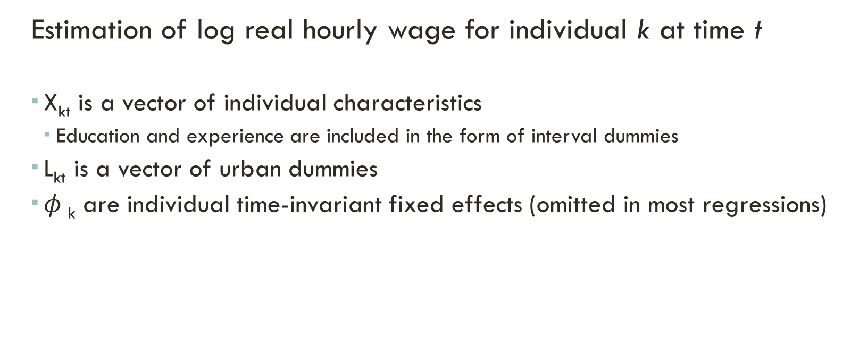
GLaeser, E.L., Maré, D.C. (2001), Cities and Skills
Estimation of log real hourly wage for individual k at time t
X_{kt} is a vector of individual characteristics
Education and experience are included in the form of interval dummies
L_{kt} is a vector of urban dummies
$φ$_{k} are individual time-invariant fixed effects (omitted in most regressions)

Slide 26
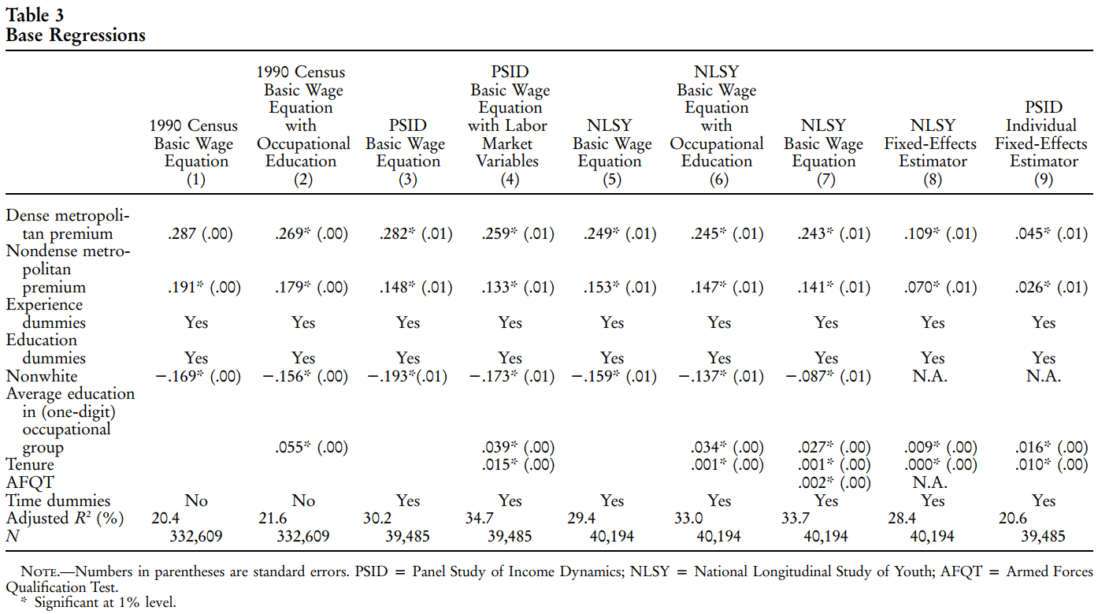
Notes:
Controlling for individual fixed effects heavily reduces the urban premium → wage growth

Slide 27
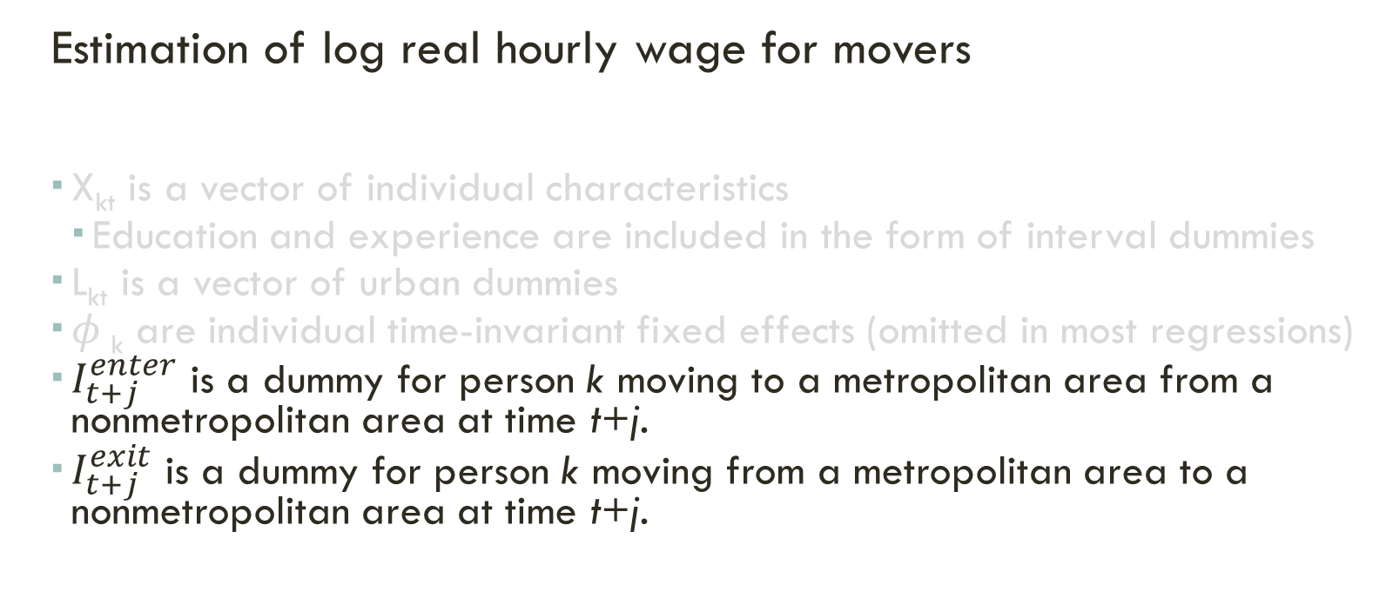
GLaeser, E.L., Maré, D.C. (2001), Cities and Skills
Estimation of log real hourly wage for movers
X_{kt} is a vector of individual characteristics
Education and experience are included in the form of interval dummies
L_{kt} is a vector of urban dummies
$φ$_{k} are individual time-invariant fixed effects (omitted in most regressions)
$I_{t+j}^{enter}$ is a dummy for person k moving to a metropolitan area from a nonmetropolitan area at time t+j.
$I_{t+j}^{exit}$ is a dummy for person k moving from a metropolitan area to a nonmetropolitan area at time t+j.

Slide 28
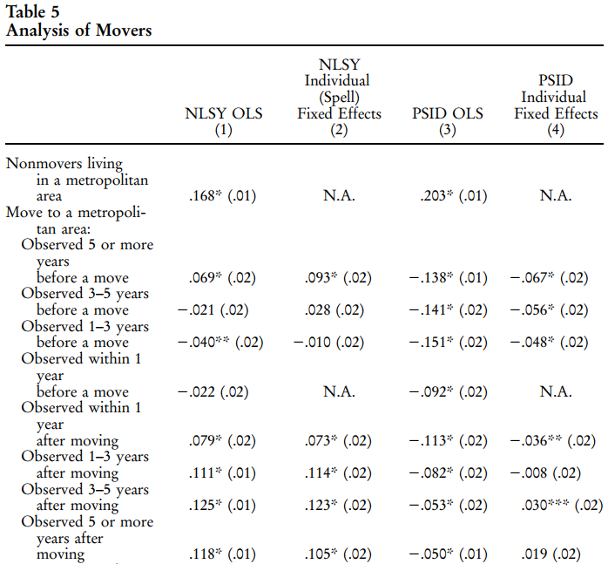
Notes:
Young rural-to-urban migrants experience quick wage gains → wage level
Rural-to-urban migrants experience modest wage gains over time → wage growth

Slide 29
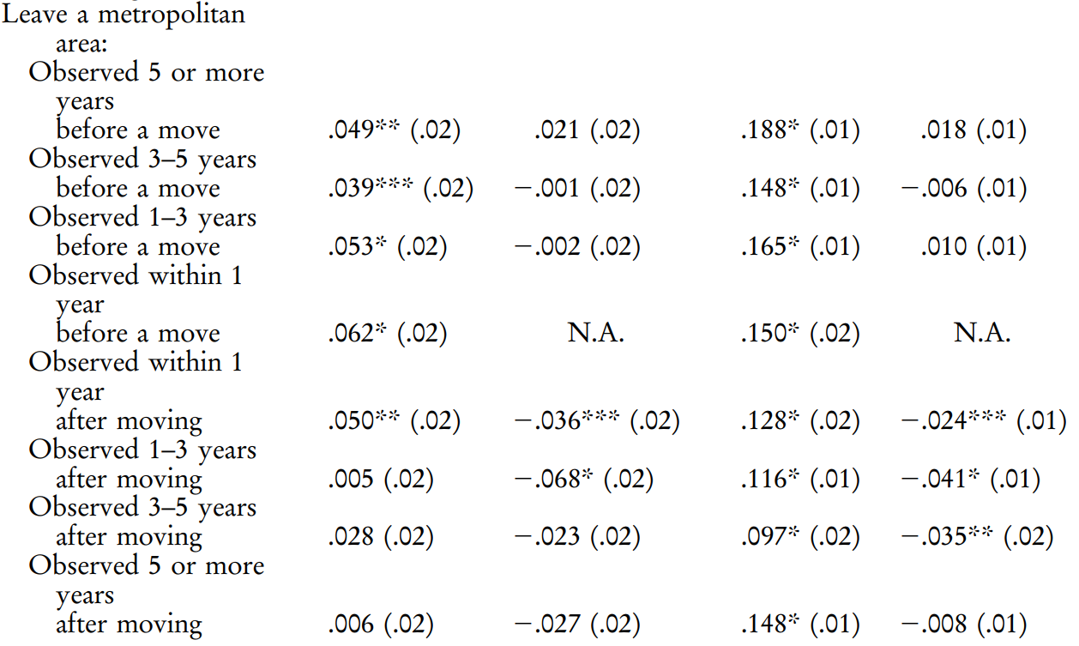
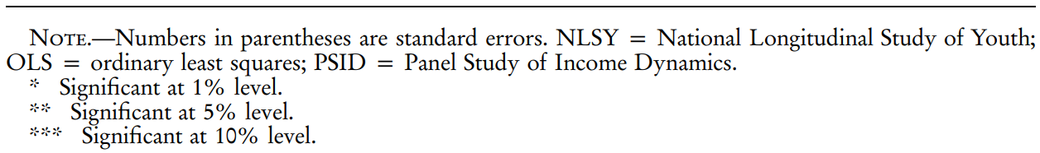
Notes:
Urban-to-rural migrants do not experience immediate significant wage losses → wage growth
After 1st year they do though. Some workers might only leave cities if they are facing a solid contract.

Slide 30
Glaeser, E.L., Maré, D.C. (2001), Cities and Skills
Q: IS THE URBAN WAGE PREMIUM DUE TO OMITTED ABILITY BIAS?
Omitted ability bias: Declined
Initial endowment with observable basic ability and human capital characteristics are only weakly correlated with cities
Correcting for local prices decreases wage premium → Weak correlation between city size and real wages
Migrants to cities also receive a wage premium (even controlling for individual fixed-effects)

Slide 31
Glaeser, E.L., Maré, D.C. (2001), Cities and Skills
Q: IS THE URBAN WAGE PREMIUM A WAGE LEVEL EFFECT OR A WAGE GROWTH EFFECT?
Findings are ambiguous and not overwhelming
In favor of wage level theory:
Young rural-to-urban migrants experience quick wage gains
In favor of wage growth theory:
Rural-to-urban migrants experience modest wage gains over time
Urban-to-rural migrants do not experience immediate significant wage losses
After 1st year they do though.
Some workers might only leave cities if they are facing a solid contract.
Controlling for individual fixed effects reduces the urban premium heavily (table 3)

Slide 32
Combes P; Duranton G and Gobillon L (2008) Spatial wage disparities: Sorting matters!
Explain large spatial wage disparities:
1st: differences in wages across areas could directly reflect spatial differences in the skill composition of the workforce
2nd: wage differences across areas are caused by differences in local non-human endowments
3rd: interactions between workers or between firms take place locally and lead to productivity gains

Slide 33
Combes P; Duranton G and Gobillon L (2008) Spatial wage disparities: Sorting matters!
DATA
DADS (Annual Social Data Declarations database) are collected by the French Institute for Statistics (INSEE) from all employers and self-employed in France for pension, benefits and tax purposes
data contains 19,675,740 (after cleaning 2,221,156) observations from 1976 to 1998 with personal data (age, gender, occupation), establishment level (incl. location - covered by 341 employment areas), No. of days worked and earnings
focused only on total labour costs for full-time employees
real wage = total labour cost per full working day

Slide 34
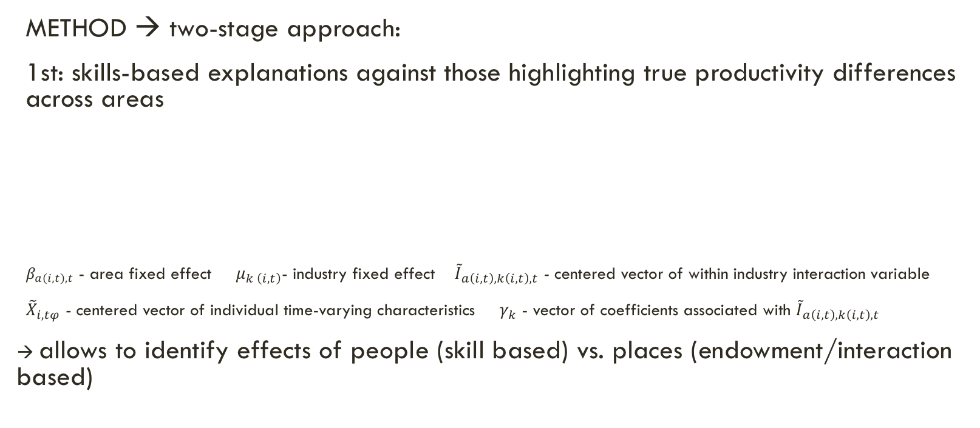
Combes P; Duranton G and Gobillon L (2008) Spatial wage disparities: Sorting matters!
METHOD → two-stage approach:
1st: skills-based explanations against those highlighting true productivity differences across areas
$β_{a\left(i,t\right),t}$ - area fixed effect $μ_{k \left(i,t\right)}$- industry fixed effect ${\tilde{I}}_{a\left(i,t\right),k\left(i,t\right),t}$ - centered vector of within industry interaction variable
${\tilde{X}}_{i,tφ}$ - centered vector of individual time-varying characteristics $γ_{k}$ - vector of coefficients associated with ${\tilde{I}}_{a\left(i,t\right),k\left(i,t\right),t}$
→ allows to identify effects of people (skill based) vs. places (endowment/interaction based)

Slide 35
Combes P; Duranton G and Gobillon L (2008) Spatial wage disparities: Sorting matters!
Results - Stage 1:
overwhelming importance worker effects
within-industry interactions, their explanatory power is very small
explanatory power of area-fixed effects is substantial
→ large spatial wage disparities reflect true productivity differences across areas that are magnified by the sorting of workers by skills
Notes:
When the effect of a variable has a large standard deviation and it is highly correlated with wages, variable has a large explanatory power

Slide 36
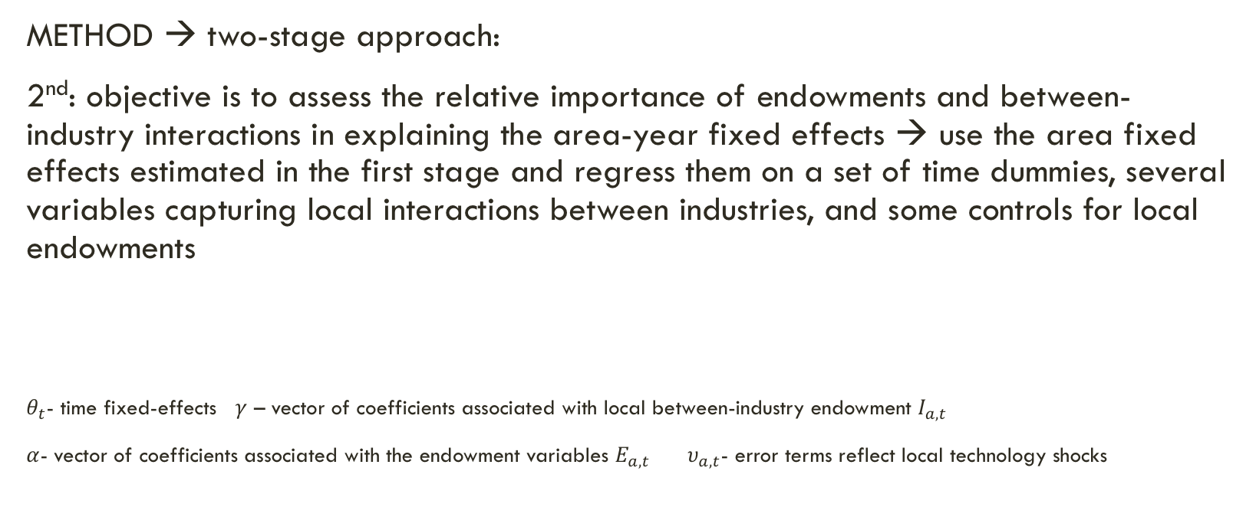
Combes P; Duranton G and Gobillon L (2008) Spatial wage disparities: Sorting matters!
METHOD → two-stage approach:
2nd: objective is to assess the relative importance of endowments and between-industry interactions in explaining the area-year fixed effects → use the area fixed effects estimated in the first stage and regress them on a set of time dummies, several variables capturing local interactions between industries, and some controls for local endowments
$θ_{t}$- time fixed-effects $γ$ – vector of coefficients associated with local between-industry endowment $I_{a,t}$
$α$- vector of coefficients associated with the endowment variables $E_{a,t}$ $υ_{a,t}$- error terms reflect local technology shocks
Notes:
2nd stage reg. of log real weakly earnings for individual i in region j

Slide 37
Combes P; Duranton G and Gobillon L (2008) Spatial wage disparities: Sorting matters!
Stage 2:
Importance of employment density
Density effect and that of local fixed effects are very correlated
effect of diversity and amenities close to zero
Notes:
Log density of local employment, log of land area, log diversity of the local composition of economic activity, log market potential computed from the density of neighbouring areas

Slide 38
Ahrend, Farchy, Kaplanis & Lembcke (2017) What makes cities more productive? Evidence from five OECD countries on the role of urban governance
Novelty 1: database, with a harmonized definition of cities, which enables a cross-country analysis of the impact of city size and governance structures on urban productivity
→ paper combines evidence from five OECD member countries (Germany, Mexico, Spain, United Kingdom, and United States).
Novelty 2: focus on the role of urban governance and the complexity that arises from administrative fragmentation within cities boundaries
THESIS 1: larger number of local governments might offer productivity advantages due to competition
THESIS 2: implementation of policies that requires coordination (bureaucracy) can hamper productivity of urban agglomeration

Slide 39
Ahrend, Farchy, Kaplanis & Lembcke (2017) What makes cities more productive? Evidence from five OECD countries on the role of urban governance
Novelty 1: database, with a harmonized definition of cities, which enables a cross-country analysis of the impact of city size and governance structures on urban productivity
→ paper combines evidence from five OECD member countries (Germany, Mexico, Spain, United Kingdom, and United States).
Novelty 2: focus on the role of urban governance and the complexity that arises from administrative fragmentation within cities boundaries
THESIS 1: larger number of local governments might offer productivity advantages due to competition
THESIS 2: implementation of policies that requires coordination (bureaucracy) can hamper productivity of urban agglomeration

Slide 40
Ahrend, Farchy, Kaplanis & Lembcke (2017) What makes cities more productive? Evidence from five OECD countries on the role of urban governance
DESCRIPTIVE EVIDENCE 1
Country-by-country regression show productivity to be higher in larger countries in all five countries
→ effect even stronger when presence of governance body is taken into account

Slide 41
Ahrend, Farchy, Kaplanis & Lembcke (2017) What makes cities more productive? Evidence from five OECD countries on the role of urban governance
DESCRIPTIVE EVIDENCE 2
Within countries administrative fragmentated cities to have lower levels of economic productivity
→ presence of a governance body mitigates the negative effect of fragmentation
Notes:
measured by the number of municipalities per 100,000 inhabitants

Slide 42
Ahrend et al. (2017) What makes cities more productive? Evidence from five OECD countries on the role of urban governance
METHOD
harmonized approach is made possible through the use of an internationally comparable definition of “FUNCTIONAL URBAN AREAS” that is based on economic linkages, rather than administrative boundaries
two-step-empirical approach:
1st:
𝑦𝑖𝑎𝑡 – natural log. of wages for individual i in city a at time t
X – vector of individual characteristics
d – dummy living in city or not
𝛾 – productivity differential across cities
Notes:
administrative boundaries do not include commuting workers → bias

Slide 43
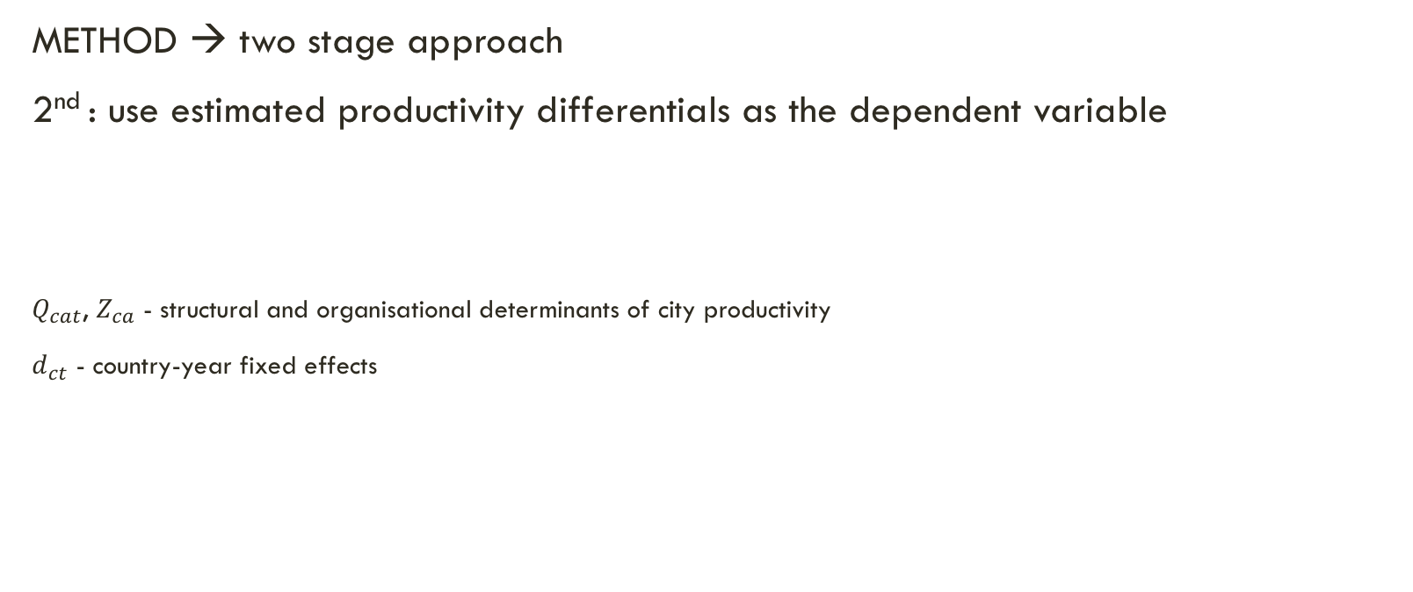
Ahrend et al. (2017) What makes cities more productive? Evidence from five OECD countries on the role of urban governance
METHOD → two stage approach
2nd : use estimated productivity differentials as the dependent variable
$Q_{cat}$, $Z_{ca}$ - structural and organisational determinants of city productivity
$d_{ct}$ - country-year fixed effects
Notes:
specific controls that can be included are limited to the controls available in all five data sets - data sources include both panel data as well as repeated cross-sections (age, education, occupation, gender and an indicator for part-time work, in addition to the city-year fixed effects )

Slide 44
Ahrend et al. (2017)
RESULTS
strong evidence for sizeable agglomeration benefits disentangled by a specification (I-II)
further focus on governmental fragmentation (III–X)
NOTE: controled for city size
Suggestions:
diversified industrial structure has a positive impact on productivity (VIII)
share of employees in specific industries exhibit higher productivity
Share of high-tech manufacturing workers → higher productivity – lowers with technological intensity of the manufacturing industry
Notes:
city with double the number of residents is associated with 3.8%higher productivity ; coefficients for population and area are similar indicating that both an increased population for a given area, and an increased area, while population density remains constant, have similar productivity effects - aggregate human capital, measured by the share of university graduates in the city,

Slide 45
IV. Other Longitudinal SURVEYS
European Union
EU-SILC - Statistics on Income and Living Conditions: Panel of 200,000 households, 2003-
ECHP - European Community Household Panel: 1994-2001
Spain
EPA - La Encuesta de Población Activa: Panel of 65,000 households, quarterly, 1964-
UK
Nick Coleman (2015) Summary of longitudinal surveys: On education in England (16 surveys), cross-country, & in 13 other countries

Slide 46
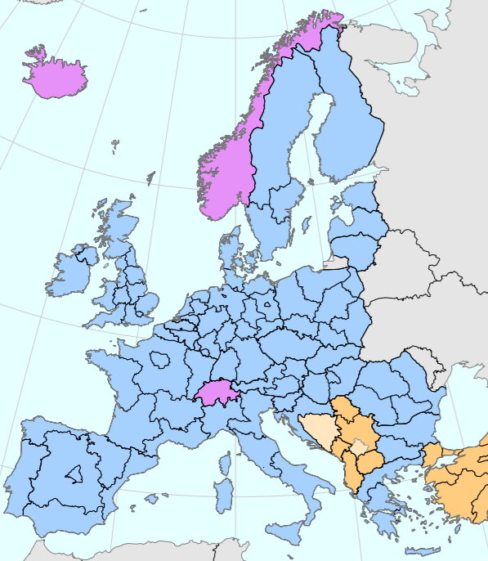
IV. MEASURES in EU-SILC
Employee Income:
Gross employee cash or near cash income
Gross non-cash income
Employer’s social insurance contributions
Education
ISCED2011 levels of education (International Standard Classification of Education)
Year when highest level was attained
Regions at NUTS 1 Level in
All EU countries (blue)
EFTA countries (purple)
Macedonia, Serbia, and Turkey (yellow)

Slide 47
V. Concluding remarks
Differences in skill-composition can explain much of the inequality between regions
Heterogeneity in ability such as education is key
But people born in cities do not have a genetical advantage
There is mixed evidence on a regional fixed effect from working in a city
UK: No effect.
US: Effect increases with density.
Fr: Between-industry-interaction effects, little effect from local endowments.
US, ME, DE, UK, ES: Evidence for agglomeration effect and governmental fragmentation
There is a persistent interaction effect from experience in an urban area

Slide 48
THANK YOU FOR YOUR ATTENTION!

